Slide 1
Secure Data hiding using steganography
CAPSTONE PROJECT
Presented By:
Student Name : Devesh Dubey
College Name & Department : Sage University, Indore ( B.Tech CSE )

Slide 2
OUTLINE
Problem Statement
Technology used
Wow factor
End users
Result
Conclusion
Git-hub Link
Future scope

Slide 3
Problem Statement
In today’s digital age, secure communication is crucial. Traditional methods of hiding messages in images often lack user-friendly interfaces and robust security. This project addresses the need for a simple, secure, and visually appealing tool to embed and extract secret messages within images using steganography, ensuring privacy and ease of use.

Slide 4
Technology used
Frontend: HTML, Tailwind CSS (for modern and responsive UI), JavaScript (for logic and interactivity).
Steganography: LSB (Least Significant Bit) technique to embed messages in image pixels.
Security: Base64 encoding and password protection for added security.

Slide 5
Wow factors
Sleek and Modern UI: Built with Tailwind CSS, the app offers a visually stunning and intuitive user experience.
Real-Time Feedback: Tickmark animations confirm successful file uploads, enhancing user interaction.
Password Protection: Adds an extra layer of security to encrypted messages.
Cross-Platform: Works seamlessly on all devices (desktop, tablet, mobile) with a responsive design.

Slide 6
End users
Individuals: For personal use to securely share confidential messages.
Businesses: To protect sensitive information during digital communication.
Educators and Students: To learn and demonstrate steganography concepts in a practical way.

Slide 7
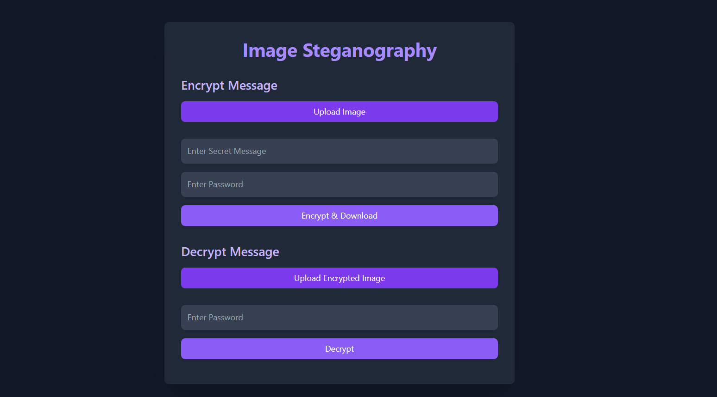
Results

Slide 8
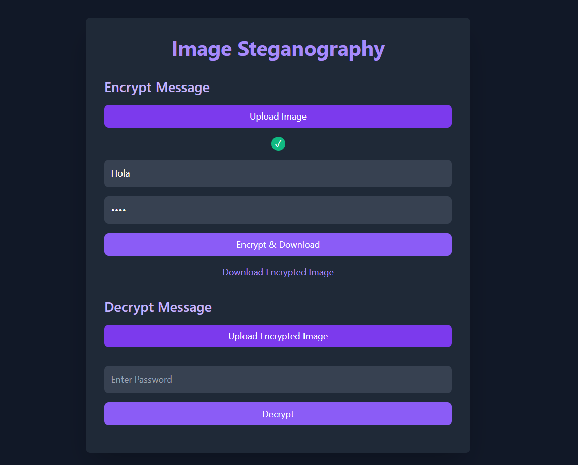

Slide 9
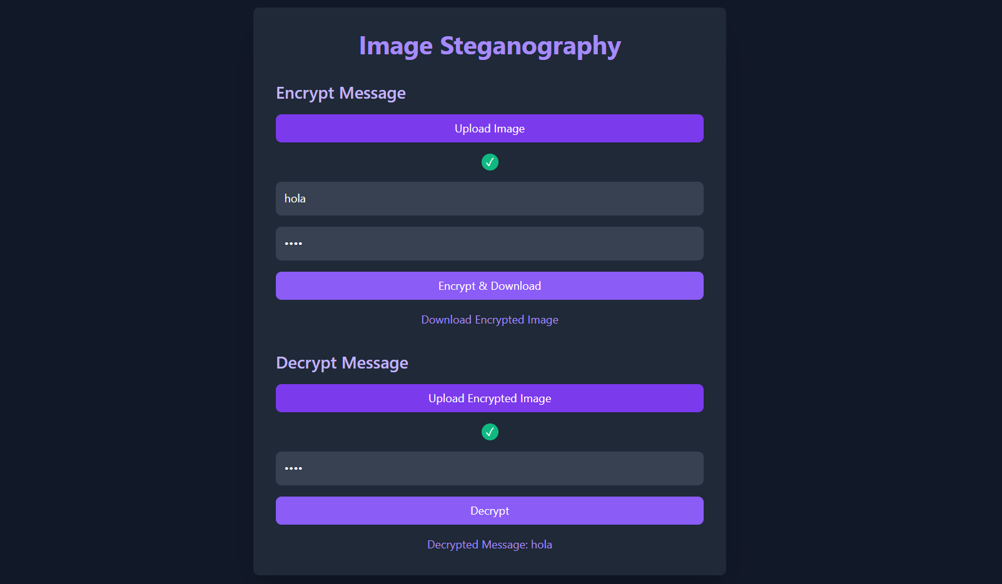

Slide 10
Conclusion
This project combines security, simplicity, and aesthetics to create a powerful steganography tool. By leveraging modern web technologies and an intuitive design, it provides a seamless experience for users to encrypt and decrypt messages within images, ensuring privacy and ease of use in a visually appealing package.

Slide 11
GitHub Link
https://github.com/Dubeyguy/Steganography.git

Slide 12
THANK YOU

